Slide 1
SPAM SMS PREDICTION USING DATA CLASSIFICATION TECHNIQUES
BY
- Roshani Aher (4302)
- Monika Bodake (4309)
- Vishwaja Chaudhari (4311)
- Rachana Fulsundar (4320)

Slide 2
Problem Statement: Based on different classification algorithm predict the given SMS spam or not.
Motivation: SMS are the most important forms of communication. Spam is one of the major threats sent to each user. Therefore effective spam filtering technology is significant contribution to sustainability of the cyberspace and our society.

Slide 3
ETL process:
Data Extraction :-
Data Extraction from .csv File
Data Transformation :-
Removing unwanted columns and missing data from dataset.
Natural language processing on SMS
Scaling given text data into vector form using TfidfVectorizer
Data Loading :-
Load the extracted data into for testing and training set.

Slide 4
Dataset Description:
Dataset for spam prediction is taken from kaggle dataset.
It contain the message and it’s class (spam or ham).
We have total 5572 data samples.
15% data is used for testing and remaining is for testing.

Slide 5
Tools used:
Spyder and tkinter are used in our project
Techniques followed:
Used following three classification algorithms: 1. Naïve Bayes
2. Decision Tree Classifier
3. Random Forest Tree

Slide 6
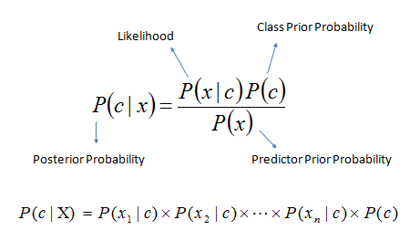
Naïve Bayes Classification
Assumes that the presence of a particular feature in a class is unrelated to the presence of any other feature.
Convert the data set into a frequency table.
Create Likelihood table by finding the probabilities .
Now, use Naive Bayesian equation to calculate the posterior probability for each class. The class with the highest posterior probability is the outcome of prediction.

Slide 7
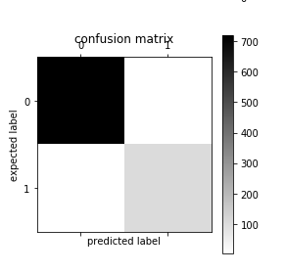

Confusion Matrix of NB:

Slide 8
Decision Tree Classification
Place the best attribute of the dataset at the root of the tree.
Split the training set into subsets. Subsets should be made in such a way that each subset contains data with the same value for an attribute.
Repeat step 1 and step 2 on each subset until you find leaf nodes in all the branches of the tree.
Attribute Selection methods:-
Gini index: - How often a randomly chosen element would be incorrectly identified.
- It means an attribute with lower gini index should be preferred.
Information gain: Try to estimate the information contained by each attribute

Slide 9

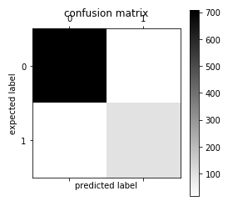
Confusion Matrix of DTC:

Slide 10
Random Forest Classification
Random forest builds multiple decision trees and merges them together to get a more accurate and stable prediction.
Advantage: Can be used for classification and regression both.
Only a random subset of the features is taken into consideration by the algorithm for splitting a node.
Prevents overfitting most of the time.
Parameters : 1. Increase the predictive power
2. Make the model faster

Slide 11

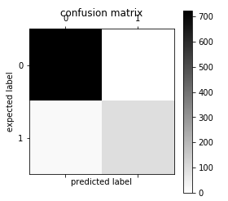
Confusion Matrix of RFC:

Slide 12
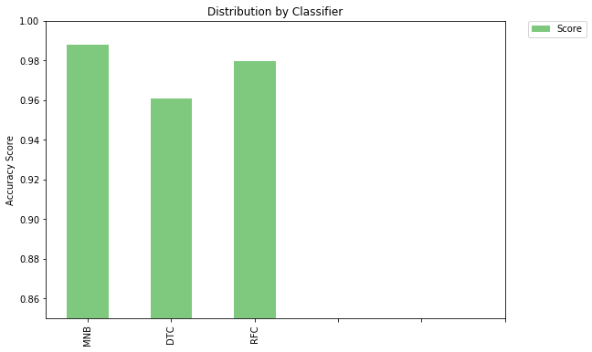
Comparison of three classification algorithms:
Accuracy: NB : 0.988038
DTC : 0.960526
RFC : 0.979665

Slide 13
Conclusion:
Successfully classified the spam SMS using different classification algorithms. The average accuracy of SMS class prediction is about 95%.
Algorithm selection and the pre-processing should be based on the application requirement.

Slide 14
References:
https://www.kaggle.com/uciml/sms-spam-collection-dataset
https://docs.python.org/2/library/tkinter.html
https://matplotlib.org/
https://www.nltk.org/

Slide 15



THNAK YOU☺

